Slide 1
Introducing Python
A first look

Slide 2
We’re going to cover…
Some information about Python
A walkthrough of a simple Python program to introduce…
Creating a Python program
A little bit on snake_case
Some elements of the Python language
General (very basic) guidance on the structure of a computer program

Slide 3
Why Python?
This can be a ’mixed blessing’. Python is relatively easy to use – but this can lead you to develop ‘bad habits’
Python is
Easy to use
Powerful
Versatile
It is used for
AI and Machine Learning
Network Programming
Web Application Programming
GUI Applications
…
It was probably ridiculous even starting to list the uses that Python has…it’s versatile

Slide 4
Python
interpreted vs. compiled?
closer to human language
Python is an interpreted, high-level programming language
Python has a dynamic type system
Python version 3 released end of 2008 – not backwards compatible with Python version 2 (which is still in use)
Python is intended to be readable
https://docs.python.org/3/faq/general.html#what-is-python
dynamic vs. static?
Python is also strongly typed
Please don’t confuse them!
Or you’ll be wondering why your program isn’t working…

Slide 5
Dynamic Type System
Python decides
string
name = "Phil"
age = 52
daily_travel_miles = 37.2
What if you need to change types?
integer
float

Slide 6
Dynamic Type System
Python decides
forcing it
(if you have to)
string
name = "Phil"
age = 52
daily_travel_miles = 37.2
age1 = str(52)
age2 = float(52)
age3 = int(age1)
integer
float

Slide 7
Dynamic Type System
Python decides
forcing it
(if you have to)
string
name = "Phil"
age = 52
daily_travel_miles = 37.2
age1 = str(52)
age2 = float(52)
age3 = int(age1)
string
integer
Python knows age1 as a string
float
float
integer
more on assigning values to variables later

Slide 8
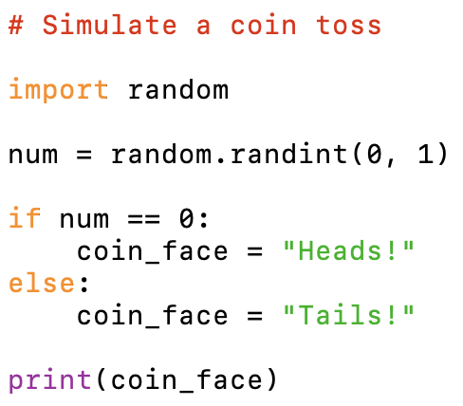
coin_toss.py
This is a simple Python program that simulates the tossing of a coin.
It generates a random number (either 0 or 1) to represent heads or tails.
If the number is 0 the program outputs ”Heads!”.
If the number is 1 the program outputs ”Tails!”.
Do you find this easy to read?

Slide 9
coin_toss.py
coin_toss is the name of the script
The .py extension indicates that it is a Python file
Convention says use snake_case for
variables, functions and file-names (lower-case with underscore separating words)
Style Guide for Python Code

Slide 10
The script is interpreted from top to bottom
You can bring in useful functionality so you don’t have to write it
Each line below the top line is an instruction for the interpreter to execute
Python is case-sensitive

Slide 11
The script is interpreted from top to bottom
You can bring in useful functionality so you don’t have to write it
Each line below the top line is an instruction for the interpreter to execute
You can assign values
Python is case-sensitive

Slide 12
The script is interpreted from top to bottom
You can bring in useful functionality so you don’t have to write it
Each line below the top line is an instruction for the interpreter to execute
You can assign values
A colon precedes a code block (in Python a ‘suite’)
You can make decisions
Python is case-sensitive

Slide 13
The script is interpreted from top to bottom
You can bring in useful functionality so you don’t have to write it
Each line below the top line is an instruction for the interpreter to execute
You can assign values
A colon precedes a code block (in Python a ‘suite’)
You can make decisions
You can output results
Python is case-sensitive

Slide 14
A comment begins with the hash character
(remainder of the line is ignored by the interpreter)

Slide 15
A comment begins with the hash character
(remainder of the line is ignored by the interpreter)
The ‘random’ module contains functions to generate random numbers
random.randint(a, b) returns a random integer from the lowerbound (a) to the upperbound (b) inclusive

Slide 16
A comment begins with the hash character
(remainder of the line is ignored by the interpreter)
The ‘random’ module contains functions to generate random numbers
random.randint(a, b) returns a random integer from the lowerbound (a) to the upperbound (b) inclusive
The ‘if’ statement does one thing if the condition is true ’else’ it does something else

Slide 17
A comment begins with the hash character
(remainder of the line is ignored by the interpreter)
The ‘random’ module contains functions to generate random numbers
random.randint(a, b) returns a random integer from the lowerbound (a) to the upperbound (b) inclusive
The ‘if’ statement does one thing if the condition is true ’else’ it does something else
Strings are surrounded
by double quotes or
single quotes ( it doesn’t matter which, just keep it consistent)

Slide 18
A comment begins with the hash character
(remainder of the line is ignored by the interpreter)
The ‘random’ module contains functions to generate random numbers
random.randint(a, b) returns a random integer from the lowerbound (a) to the upperbound (b) inclusive
The ‘if’ statement does one thing if the condition is true ’else’ it does something else
Strings are surrounded
by double quotes or
single quotes ( it doesn’t matter which, just keep it consistent)
The print() function causes output

Slide 19
1) Describe your program
(Optional) Import any modules you’ll need
2) Assign values to
variables
3) Do some processing
4) Output results

Slide 20
A guide to get you started!
Keep these at the top of your file – it helps anyone coming to read your code
A comment
0…* imports
Don’t worry about keeping these separate (although it is usually helpful to do so) – just treat the separation as loose guidance to help you structure your ideas
Setting up data
Processing data
Output results

Slide 21
Arithmetic operators
Python supports the standard arithmetic operators:
* multiply
/ divide
% remainder
+ add
- subtract
You might also find useful
** to the power of (2 ** 3 = 8)
// floor division (10 // 3 = 3)
If you need to do more then you can always import a module – the 'math' module has a lot of functionality you might find useful
https://docs.python.org/3/library/math.html

Slide 22
Operator precedence
Operators have precedence which determines the order in which they are evaluated:
operators with the same order of precedence are evaluated from left to right
[* / % //] are evaluated before [+ -]
Brackets can group operations
what are the answers to the following
(5 + 2) / 2 = ?
5 + 2 / 2 = ?

Slide 23
You should now know…
What snake_case is
How to name a Python file
A bit about Python syntax
A little bit of the Python language
The basic structure of a simple program
That Python programs are interpreted from top to bottom

Slide 24
Any questions?

